Slide 1
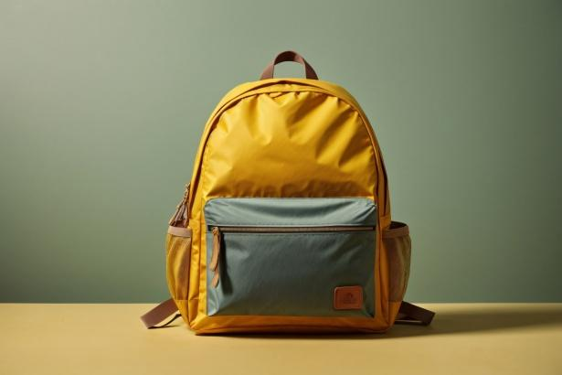
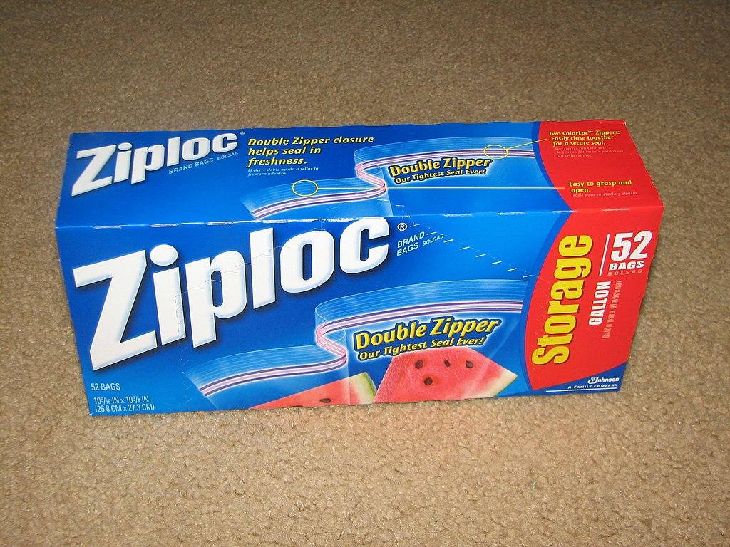
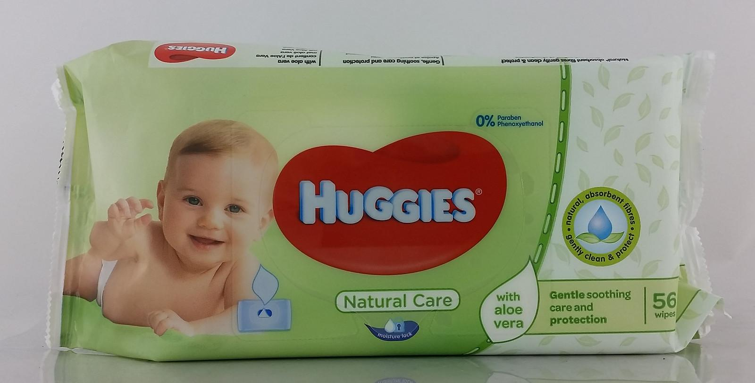
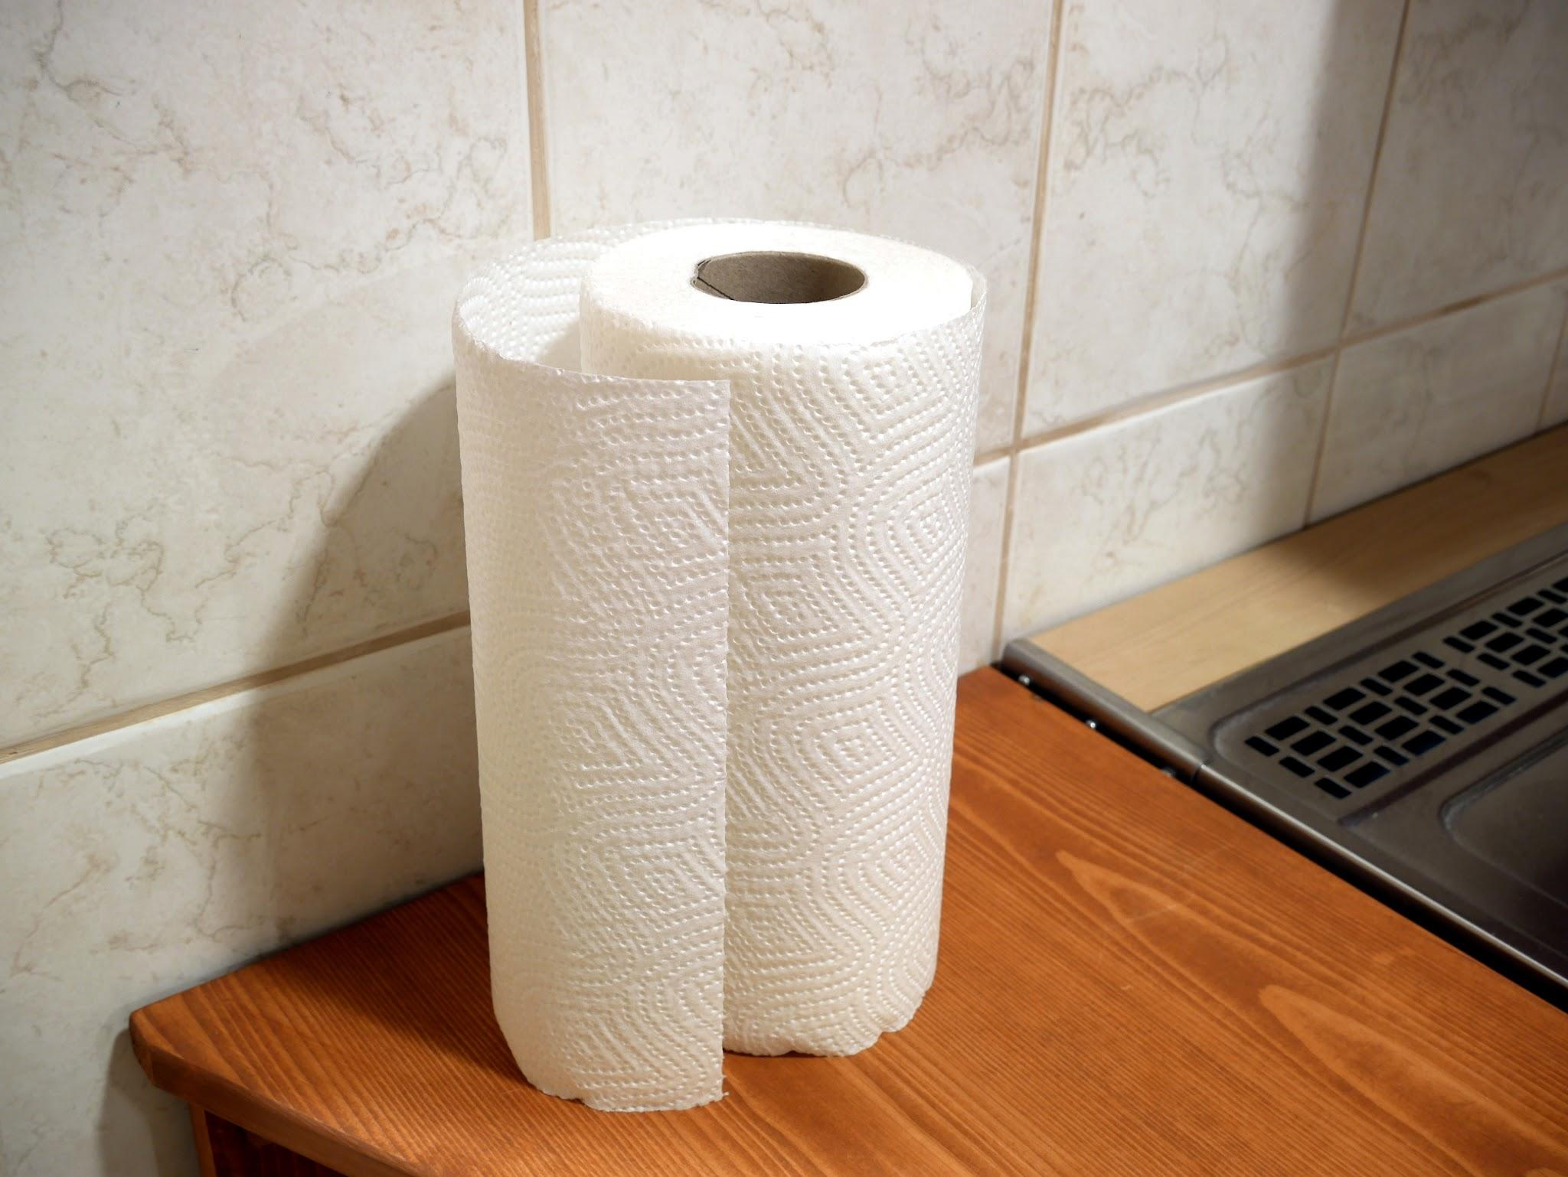
Mrs. Lawrenson’s Pre-K Supply List 25/26
1 backpack big enough to
fit a folder (No wheels)
Complete change of clothes
(including socks and underwear)
labeled with your student’s
first and last name in a gallon-sized
Ziploc bag
1 box of gallon-size Ziploc bag
1 pack of baby wipes, unscented preferred
1 roll of paper towels

